Slide 1
NE 795: Advanced Reactor Materials
Fall 2023
Dr. Benjamin Beeler

Slide 2
Last Time
Completed FCCI for metallic fuels
highlighted different compositions, and which species participate
Ce and Nd are primary FPs that diffuse into the cladding; Fe and Ni diffuse into the fuel
Metal Fuel Fabrication
injection casting process
Pyroprocessing
well established method relying on molten salt and anode deposition
Metallic fuel performance modeling
BISON, ALFUS, LIFEMETAL
all still currently require extensive assumptions

Slide 3
Mixed oxide fuel

Slide 4
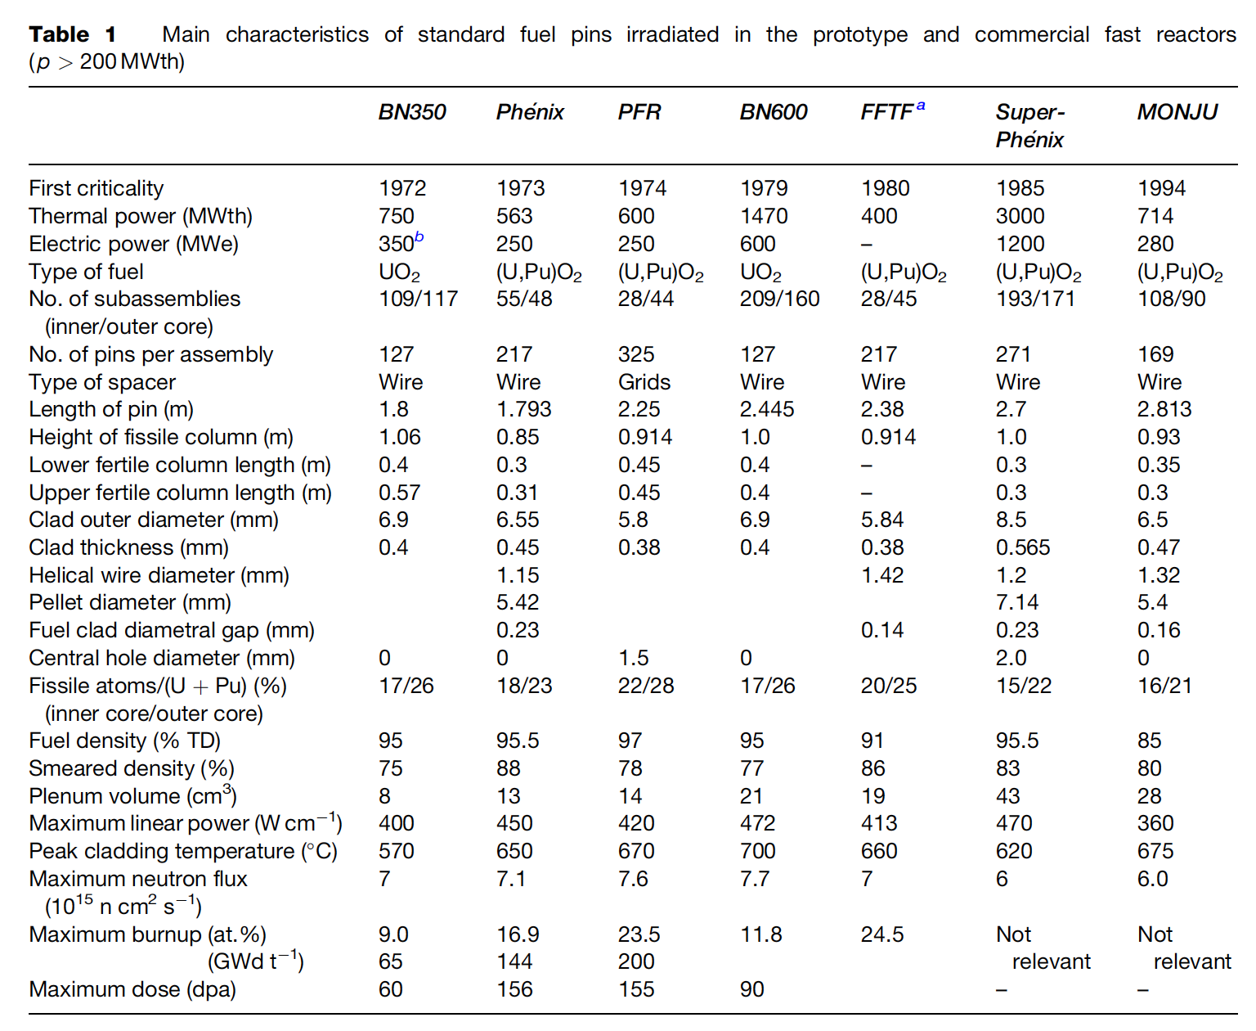
MOX Introduction
Despite some disadvantages, such as its low U density, poor thermal conductivity, and its chemical reaction with sodium, MOX fuel (U,Pu)O2 is the fuel that has been used most in fast reactors
In order to avoid the dramatic swelling of metallic fuels, MOX fuels were explored in fast reactors
Behavior was observed to be satisfactory and was relatively widely implemented in SFRs

Slide 5
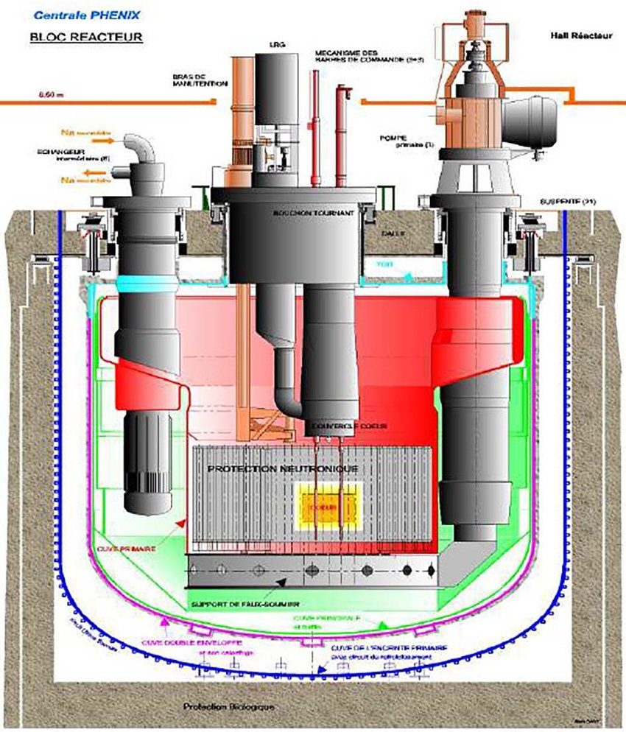
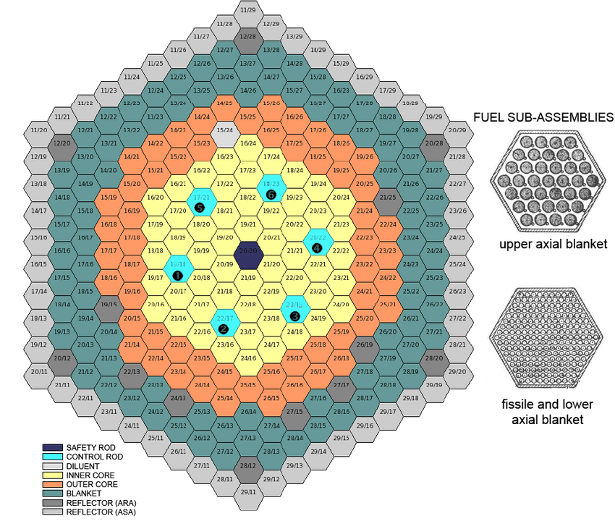
MOX Fuel Design
Typical fuel pin is 2-3 m long, with MOX pellets stacked 1 m with a plenum above and below the fueled zone
He bond, steel cladding
Hexagonal core and hexagonal assemblies
Each assembly contains 100-200 fuel pins
Schematics are from Phenix reactor

Slide 6
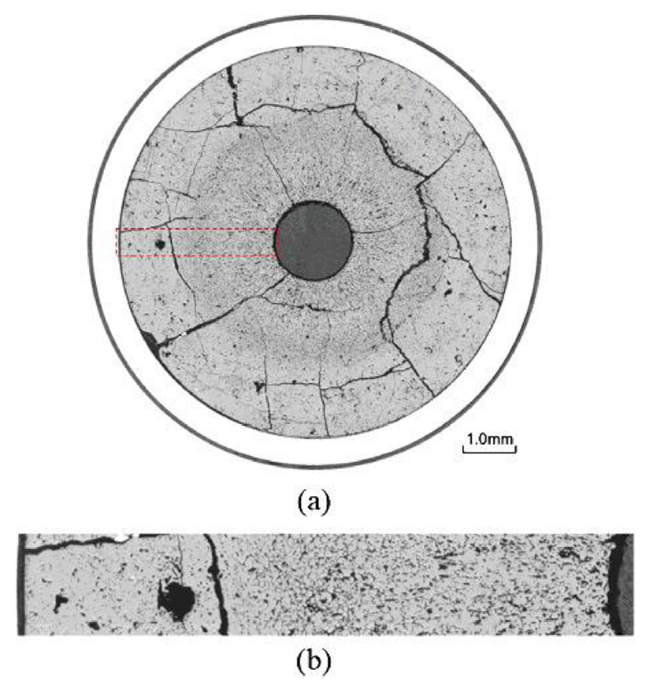
MOX Fuels in SFRs
MOX fuel operates at linear heating rates that are 2X higher than LWR fuels (450 W/cm)
MOX will run at higher temperatures than LWR fuel, and thus with different properties
Fission product phases and evolving microstructures create highly localized properties that can differ significantly from the bulk fuel
Stoichiometry and Pu content are important factors that dictate thermal properties

Slide 7
MOX Restructuring
Oxide nuclear fuels are commonly touted for their outstanding high temperature capabilities under irradiation, but this stability comes with the tradeoff of low thermal conductivity
Due to the low thermal transport, a steep temperature gradient is formed along the radius of the fuel pellet, with the hottest region at the center of the pellet and coolest near the cladding
This leads to grain growth and restructuring
Pu bearing fast reactor oxide fuels display four defining regions of a restructured pellet:
the central void, the columnar grain growth region, the equiaxed grain growth region, and the as-sintered region
The higher temperatures and heating rates form coarse, elongated grains that grow radially toward the outer rim of the fuel

Slide 8
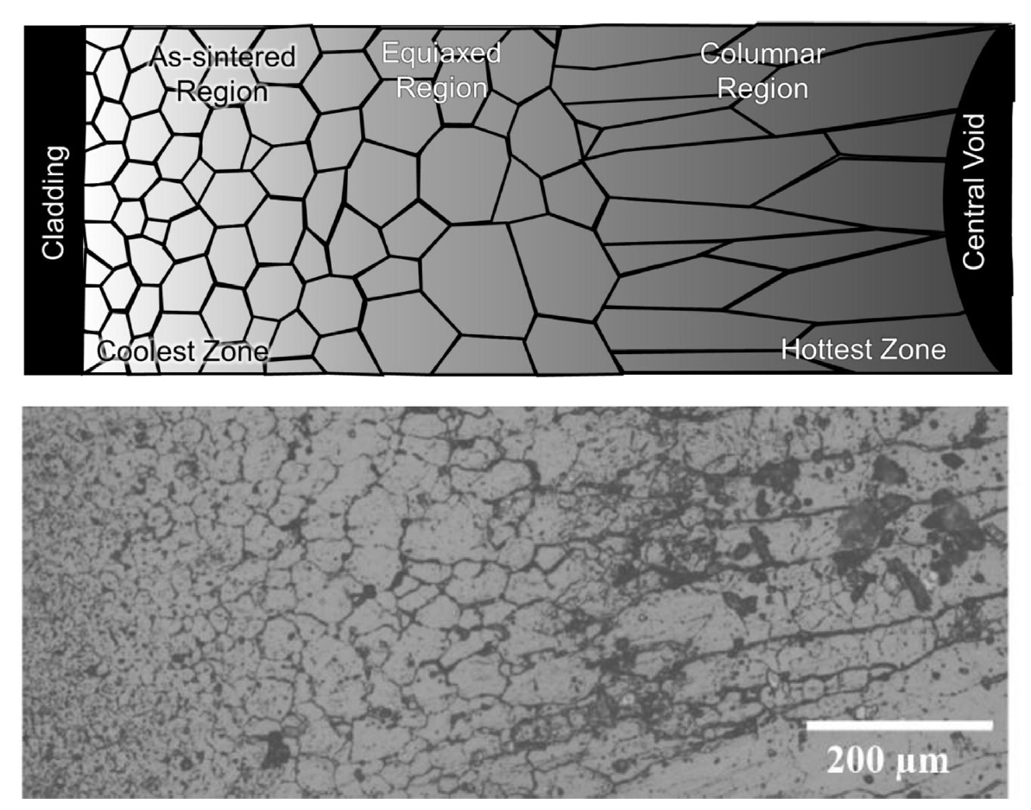
MOX Restructuring
The equiaxed region consists of grains that have undergone significant growth when compared to the un-irradiated samples
Central voids have been shown to appear in irradiation times as short as 10 min, demonstrating that the appearance the central void is a result of fuel temperature and linear heating rate, not high burnup
The central void forms from the accumulation of voids and pores present in the fuel along a thermal gradient

Slide 9
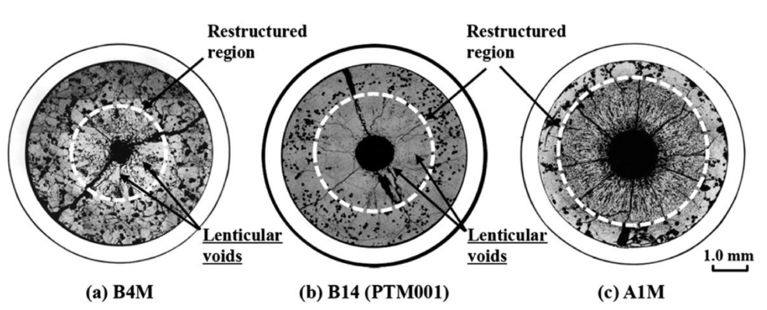
MOX Pore Formation
Heating Rate

Slide 10
MOX Pore Formation
The smallest spherical pores are highly mobile, being able to quickly and easily move through the restructured region
Intermediate sized pores become flat and elongated as they travel towards the fuel centers, leaving streaks at the tips of the voids as they travel
These “lenticular” voids are the most readily identifiable porosity feature in the irradiated MOX fuels due to their distinct shape

Slide 11
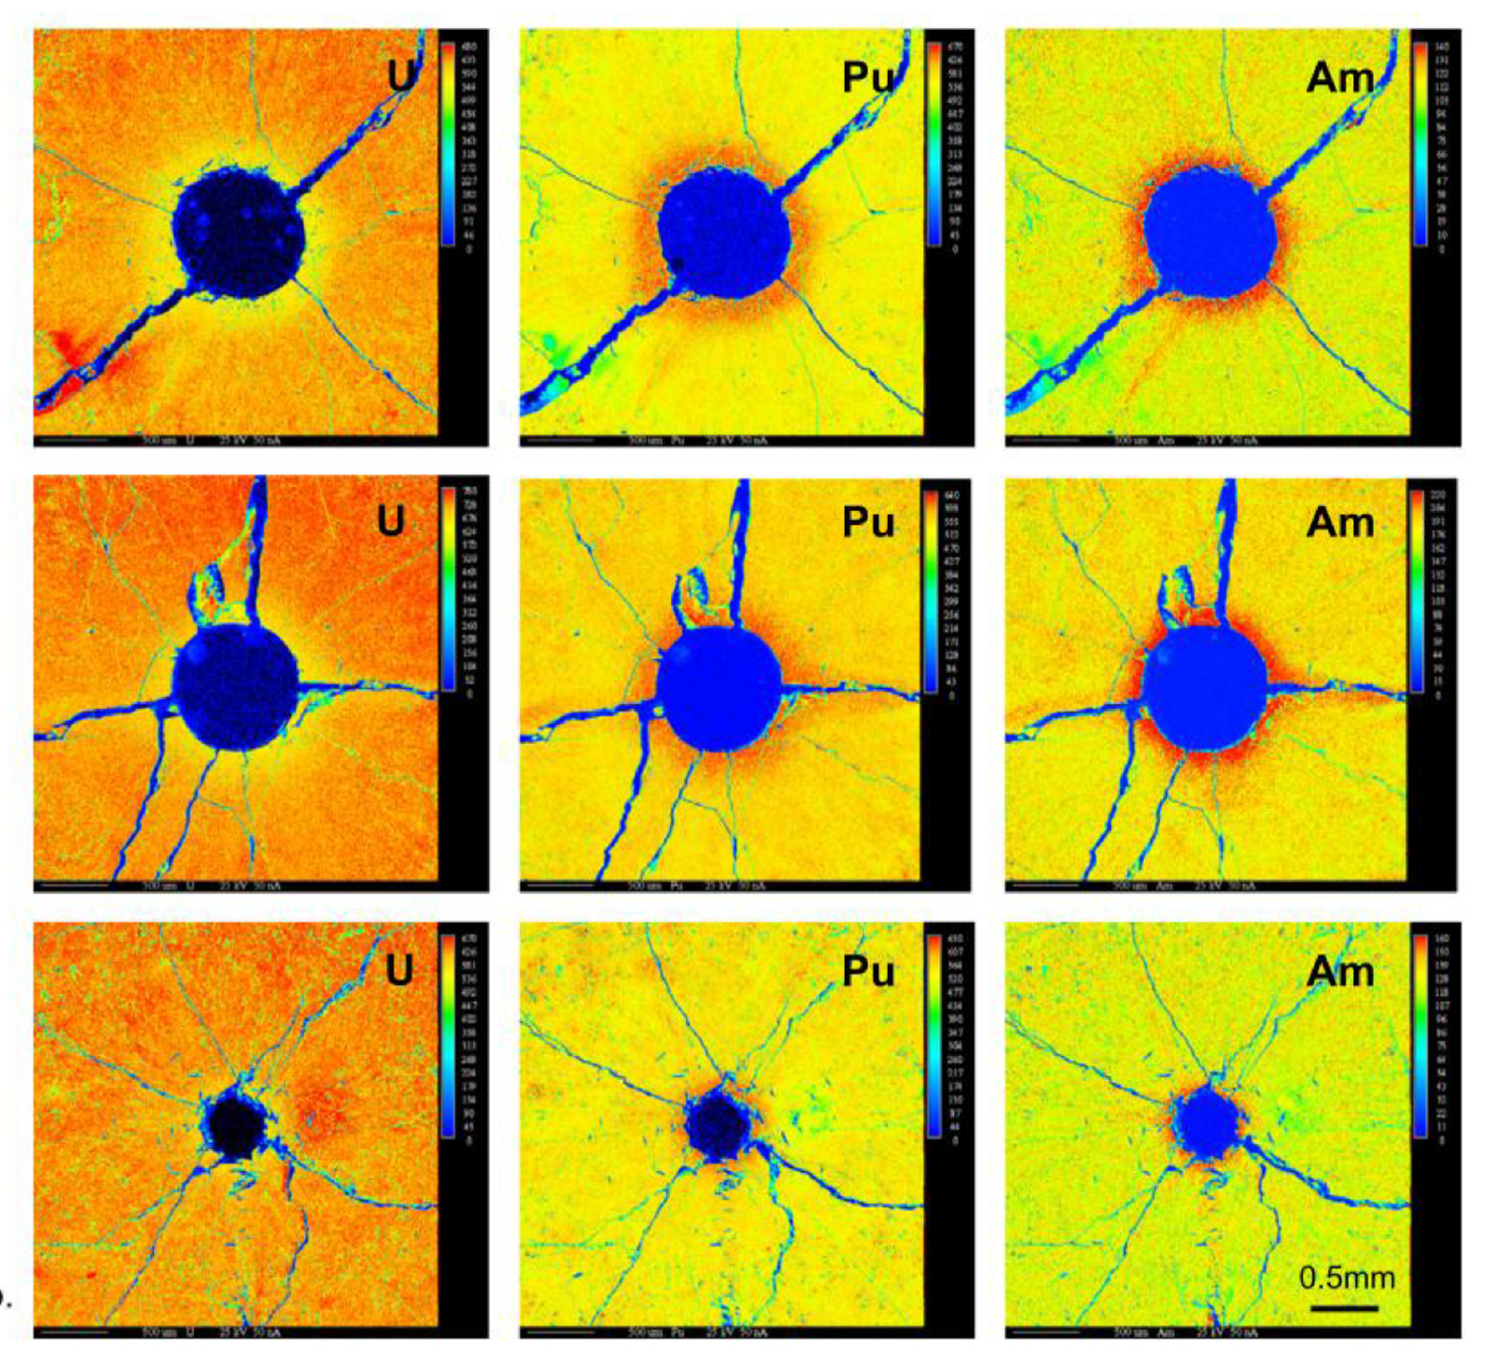
Redistribution of Pu
The movement of pores leads to a redistribution of plutonium, resulting in a spike in Pu concentration surrounding the central void
Similar behavior has been observed for americium
This transuranic concentration increase is accompanied with a decrease in U concentration
This redistribution increases the local fission rate and centerline temperature, while generating lower melting point phases

Slide 12
Redistribution of Pu
This phenomenon is currently understood as an evaporation-condensation process
The fuel at the edge of the pore closest to the centerline becomes gaseous inside the pore and deposits itself on the cooler region of the pore closest to the cladding
UO2 is the more volatile of the U/Pu heavy metal species present in the fuel matrix
The high oxygen potential can lead to a high partial pressure of UO3 within the self-contained pores
Enriched regions of PuO2 are left behind and deposited at the leading edge of the central void as the porosity agglomerates in the fuel center
Some experiments on O/M ratio seems to point towards higher O potential leading to more redistribution
While this is the working theory, it is not clear if this explanation can also account for the necessary pore velocities
No experimentally proven substitution has been put forth as a replacement theory to the observed features

Slide 13
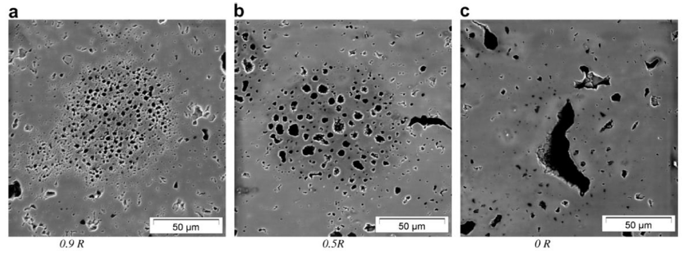
Pu-rich Agglomerates
Regions of high Pu concentration form in the MOX fuel matrix due to incomplete mixing during fabrication
Clusters of dispersed porosity form in the high Pu concentration regions because of the different fission rate
PA's are highly dense in fissile material, with the high Pu content leading to heating rates and burnups beyond the low concentration UO2 matrix material
Thermal conductivity of the spots is also lower than the surrounding matrix, thus the agglomerates are simultaneously hotter and undergo a greater number of fission events in a very small region
Burnup in these regions may be greater than 2-3 times that of the pellet as a whole

Slide 14
Pu-rich Agglomerates
The morphology of porosity in the agglomerates depends on the temperature
Toward the outer, relatively cool section of the fuel, porosity forms a large number of small bubbles, only 1-2 μm in diameter
In the intermediate radius of the pellet the densely populated, small pores start to agglomerate to form larger pores
Near the hot center of the fuel, the bubbles now reach sizes upwards of 50 μm with only a few isolated pores remaining
Porosity formed due to PA's are visually distinct from those caused by fission gas accumulation on grain boundaries and porosity formed during pellet sintering

Slide 15
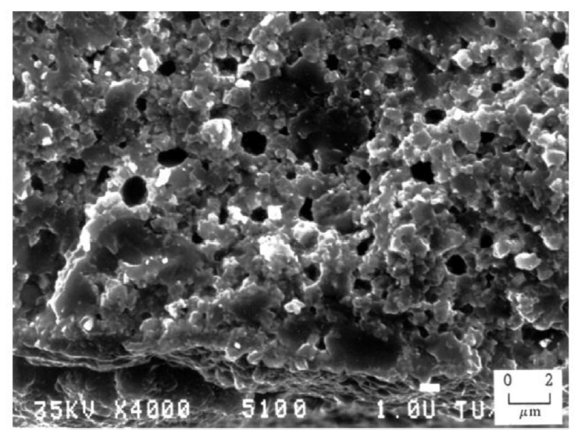
Pu-rich Agglomerates
The presence of the high burnup structure (HBS) has been observed within the PA regions
The HBS is basically a fine grained, cauliflower-like structure
In MOX fuels, the HBS structure appears in fuels following burnups between 60 and 80 GWd/tM at temperatures below approximately 1100C
PA's reach these local burnups at pellet burnups far below this threshold

Slide 16
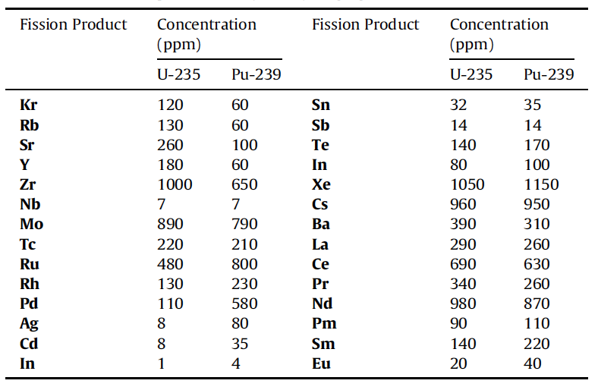
Solid Fission Products
Fission products in oxide fuels can be grouped into 4/5 categories
Fission gases and volatile species
Metallic precipitates
Oxide precipitates
Soluble oxides
LWR fuel vs Pu-containing MOX fuel, we see a higher concentration Ru, Rh, Pd, and a lower concentration of Zr and Mo

Slide 17
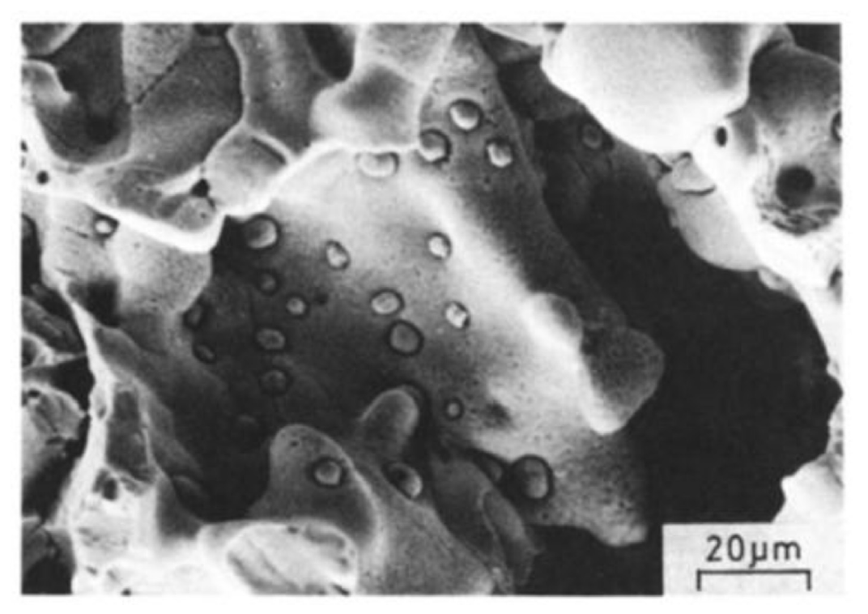
Metallic Inclusions
Mo, Tc, Ru, Rh, and Pd form prominent phases in irradiated nuclear fuels commonly referred to as “white inclusions,” “noble metal,” or “five-metal” precipitates
The particles exist as a solid solution taking on the hexagonal close packed (hcp) structure
The particle size, frequency, and composition exist over a wide range, depending on the burnup and position found within the pellet

Slide 18
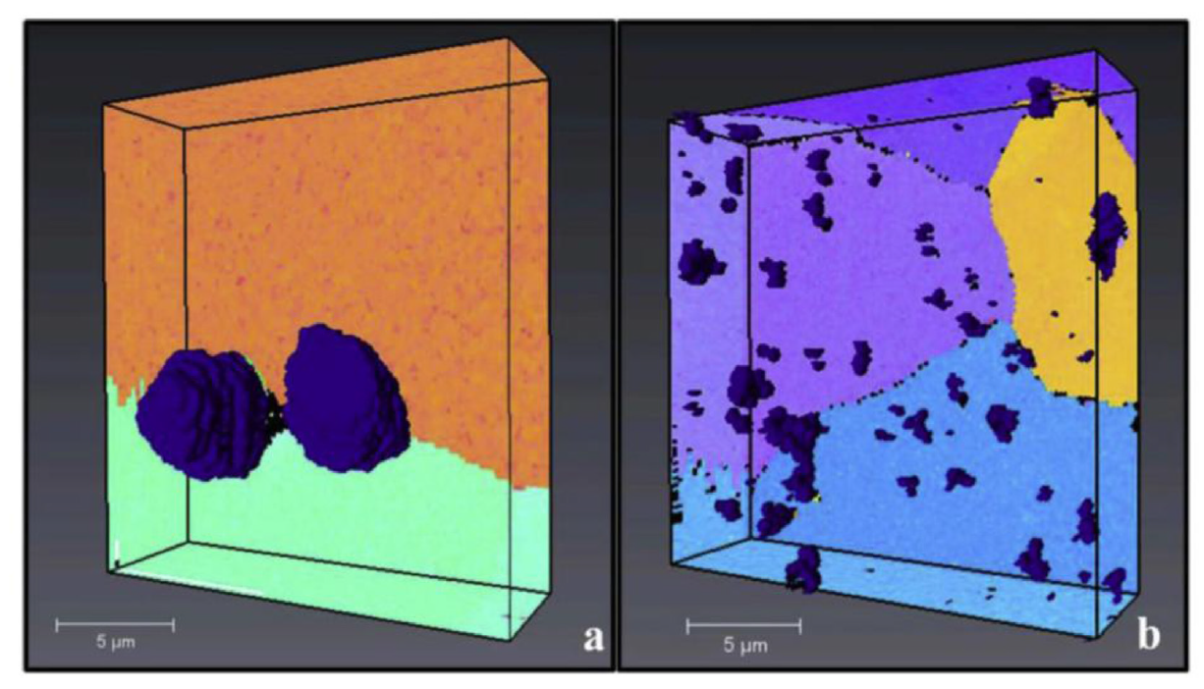
Metallic Inclusions
In the columnar grain region of the fuel, the particles are commonly 5-10 μm in diameter , collecting primarily on the grain boundaries
Particles tend to be much smaller (2 μm and below) in the equiaxed and as-sintered regions, but occur more frequently intragranularly
The particles form as a result of fission product phase agglomeration, as opposed to nucleation and growth process
Columnar Grain Region
Equiaxed Grain Region

Slide 19
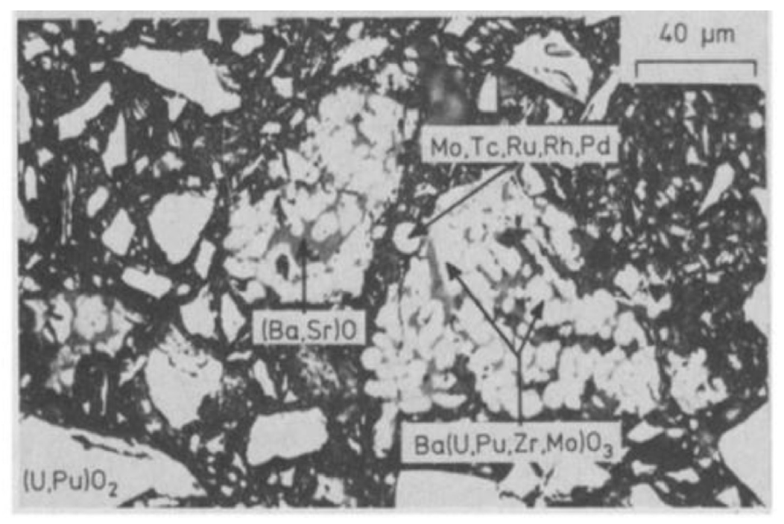
Oxide Phases
Oxides containing Sr, Zr, or the rare earth (RE) elements form solid solutions with either UO2, PuO2, or both at low concentrations
Barium is only soluble to 1.6 at% in MOX fuels and thus precipitates a separate oxide phase at higher concentrations
These oxides, commonly referred to as the “grey phase,” form ABO3 perovskite structures, in which A=(Ba1-x-y, Srx, Csy, x,y ≪1) and B=(U, Pu, Zr, Mo, RE)
The particles are primarily Ba rich, followed by Zr, U, Pu, Mo, Sr, and trace amounts of the remaining products
Due to the sheer number of constituents, the structures are largely unknown
Grey phase is typically found in the equiaxed or outermost regions of the columnar grains commonly intermixed with other constituent oxides

Slide 20
Joint Oxide Gain
The volatiles class of fission products produced during reactor operation are of particular interest to fuel-cladding interactions
Cs, Te, and I all evaporate at low operating temperatures and migrate to the coolest part of the fuel assembly where they react with fuel or cladding constituents
Mo has a tendency to combine with Cs and O to become volatile and migrate toward cooler fuel regions
This has been termed Joint Oxide Gain (JOG)
JOG is an oxide buildup formed on the fuel surface between the pellet and cladding
Primarily Cs2MoO4 or Cs2(U, Pu)O4, the JOG structure is irregular and dense, found in regions where the peak fuel temperature is lowest

Slide 21
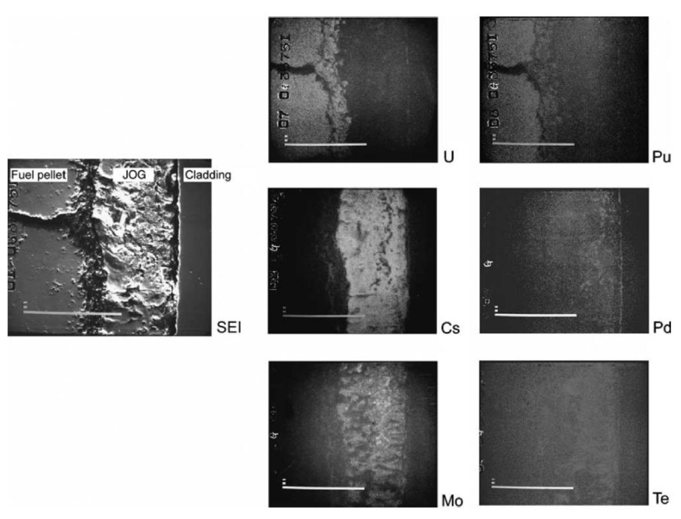
Joint Oxide Gain
The volatile constituents of the JOG structure evaporate from the fuel pellet at high temperatures and condense to become solid at the cooler top or bottom of the fuel assemblies
It is believed that the existence of JOG aids in thermal transport of the fuel, as the oxide structures have higher thermal conductivity than a fuel-cladding gap filled with fission gases

Slide 22
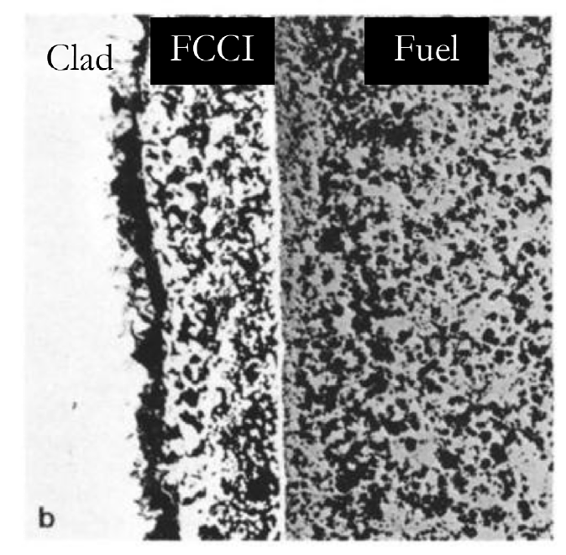
MOX FCCI
The cladding inner surface temperature of LWR MOX fuels do not reach sufficiently high temperatures under normal operating conditions to initiate detrimental oxidation and chemical attack
FCCI manifests itself in three primary modes: matrix attack, intergranular attack, or combined, which demonstrates the properties of both matrix and intergranular attack
Matrix FCCI attack corresponds to the localized oxidation of the cladding material, with primarily oxidation of the Cr in the stainless steel

Slide 23
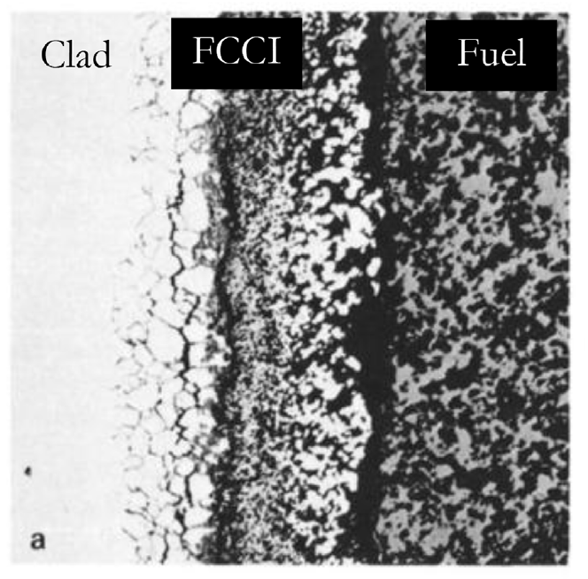
MOX FCCI
Intergranular attack modes occur due to the depletion of Cr in grain boundaries due to the formation of Cr23C6 carbides allowing penetration of corrosive species
Oxygen and volatile fission products (Cs, Te, I, etc.) are the primary culprits of FCCI initiation in oxide fuel systems
In MOX fuels, the oxygen potential of the system is the greatest difference from LWR UO2
The preferential formation of noble metals rather than oxide formers leads to an excess of available oxygen in the system

Slide 24
MOX FCCI
Under normal operation, stainless steel cladding forms a chrome oxide (Cr2O3) layer that acts to protect the cladding from corrosion
Cs is generally unreactive with stainless steel claddings, but reacts with the protective oxide layer to create Cs-chromates (Cs2CrO4 or Cs2Cr2O7) when excess oxygen is present
The decay of the protective oxide layer causes deeper penetration of the FCCI into the cladding
Iodine is primarily bound to Cs in the form of CsI, and can lead to an enhancement in oxidation in hyperstoichiometric fuels
Tellurium is highly active when combined with Cs to create Cs2Te, which can dissolve cladding constituents in the presence of high oxygen potential
The O/M ratio of the fuel before and during irradiation are significant factors, and FCCI can potentially be limited by operating with a hypostoichiometric initial fuel composition

Slide 25
MOX Summary
Phenomena of interest: Pu redistribution, Pu agglomerates, fission product chemistries, JOG formation, and FCCI
O/M ratio is one of the most significant factors in determining the nature of actinide redistribution, fission product precipitate chemistries, and FCCI formation
The effects of fission product precipitates and Pu agglomerates on fuel thermal behavior is highly localized with little discernible influence on the overall fuel burnup behavior

Slide 26
Sodium coolant

Slide 27
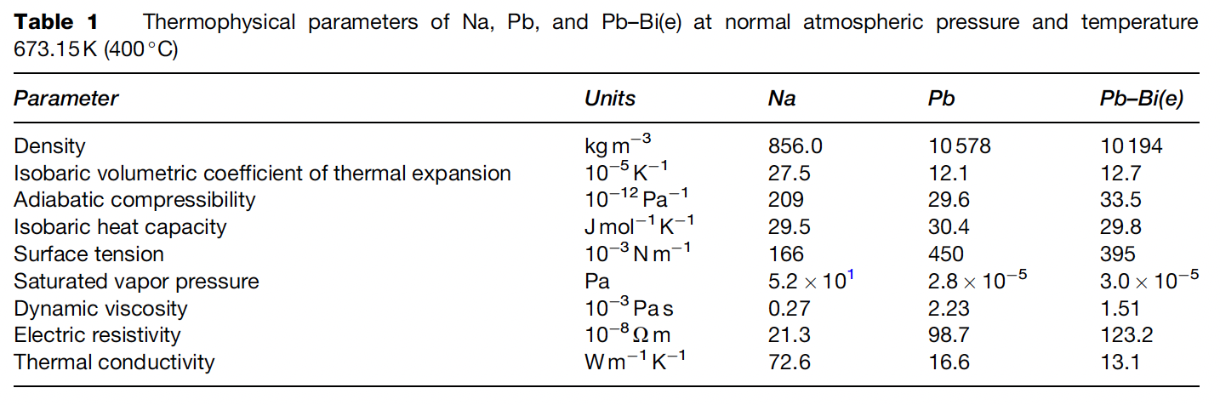
Liquid Metal Coolants
Liquid metals (LM), such as sodium (Na), lead (Pb), and lead–bismuth (Pb–Bi) eutectic, are considered as potential coolants for the fast spectrum nuclear reactors of the next generation

Slide 28
Sodium
Sodium is a solid at room temperature, and the melting and boiling temperatures are 97.82 and 881.4C, respectively.
Therefore, sodium is in the liquid phase at FR operating temperatures without pressurization
For this reason, it is not necessary to adopt the proof-pressure design employed in light water reactors for sodium-cooled FRs
Due to high thermal conductivity and specific heat, sodium can transfer the heat of the reactor core to the power generation system efficiently
Na has insignificant neutron moderation, making it suitable for the coolant for the FBR
The weakness of sodium as a coolant is its reactivity with oxygen and/or water

Slide 29
Structural Material Selection for Na
It is necessary to take the environment into consideration by estimating the mechanical properties and thermal characteristics
Environments specific to the SFR components include: (a) contact with the coolant, (b) high temperature at which the creep effects must be taken into account, and (c) neutron irradiation
The dissolution of elements contained in the material, such as iron, chromium, and nickel, in sodium and the reverse phenomenon (deposition) occur on the material surface due to the difference in chemical potential
The behavior is fundamentally controlled by the solubility of the material elements in sodium and by the diffusion rate of the materials

Slide 30
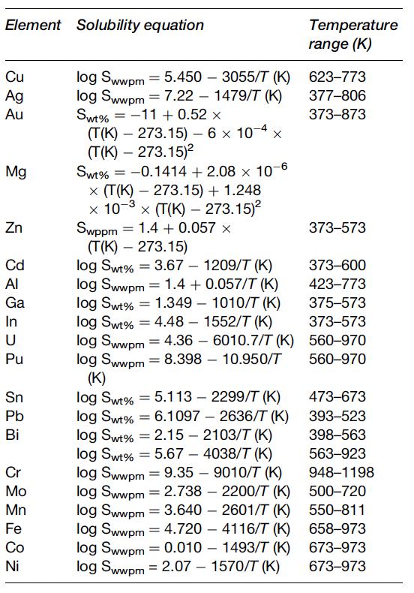
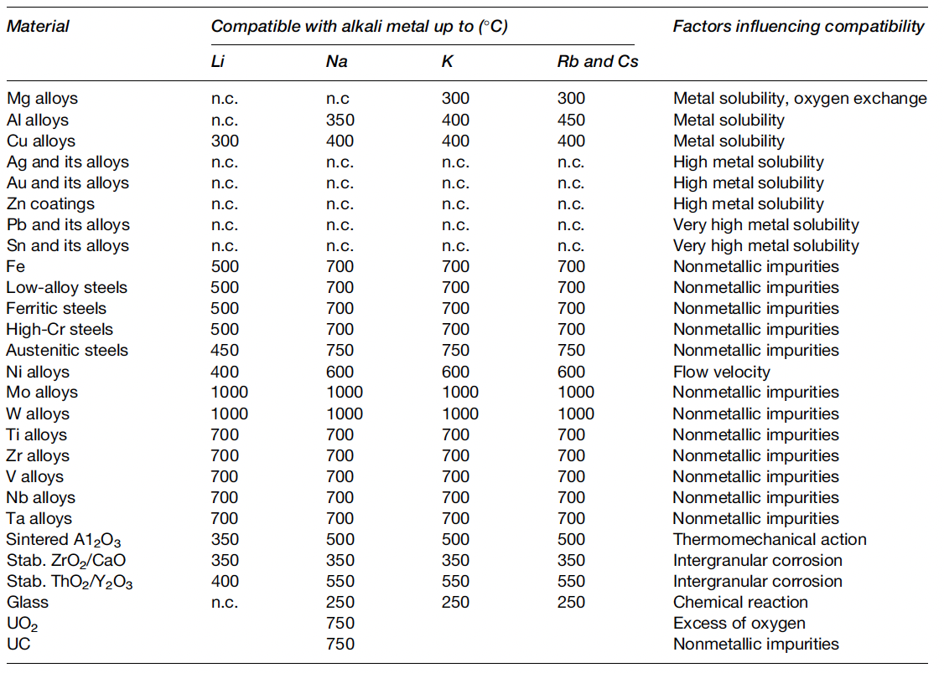
Solubilities and Compatability
Among the elements in austenitic stainless steel, the solubility of nickel is greatest
Therefore, the phase transformation of austenite to ferrite through nickel dissolution is observed on the surface in long-term immersion in sodium

Slide 31
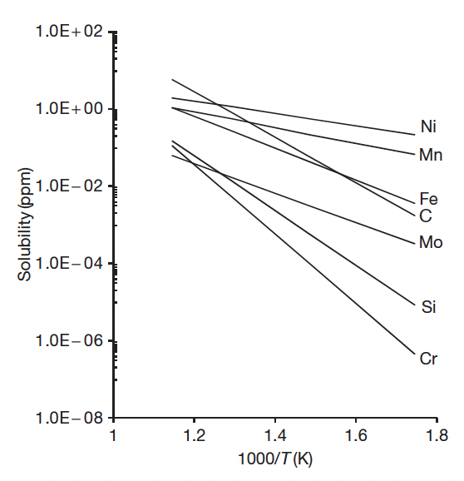
Sodium Corrosion
There are two known mechanisms of sodium corrosion
Type I: corrosion produced by the dissolution of alloy elements to sodium
Type II: corrosion produced through chemical reaction with the impurities in sodium
Type I corrosion corrosion is dependent on the solubility in sodium of the elemental composition in the material, temperature, and the rate of solution

Slide 32
Sodium Corrosion
The solubility of each of the primary components of stainless steel in sodium at 550 C is less than a few parts per million
This means that the nominal compatibility of the steels with sodium is excellent
In the isothermal sodium condition, the corrosion of the steels stops when the dissolved elements reach saturation concentration at the temperature of sodium
This corrosion behavior called thermal gradient mass transfer under non-isothermal conditions
In the cooling system, the elements in the materials in the high-temperature section dissolve as a result of the temperature dependency of the solubility of the elements in sodium, and the dissolved elements are deposited on the steel surface in the low-temperature section by the same mechanism

Slide 33
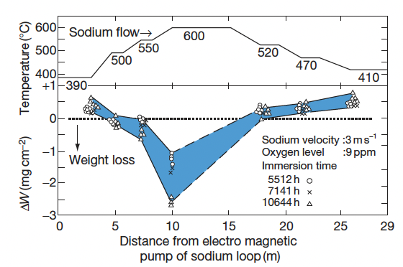
Sodium Corrosion
The results of thermal gradient mass transfer using a sodium loop made of 316SS
The weight loss caused by the dissolution of the elements in the steel is measured in the high-temperature section, and the weight gain caused by the deposit of the dissolved elements in sodium is observed in the low-temperature section

Slide 34
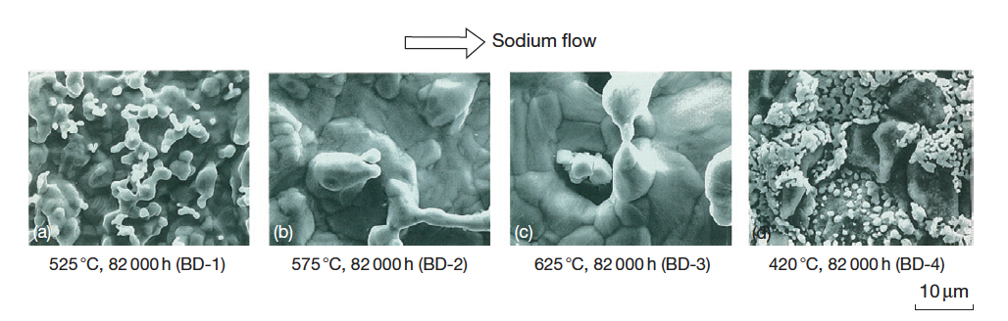
Sodium Corrosion
Dissolution of the elements in the material is observed in the high-temperature section, and precipitation is observed in the low-temperature section

Slide 35
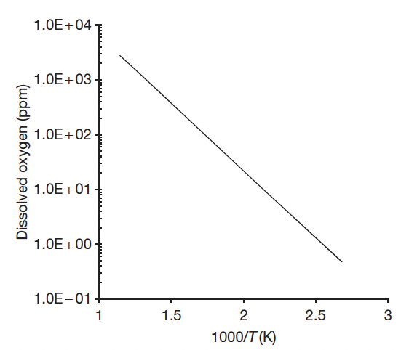
Sodium Corrosion
Type II-Corrosion Produced Through Chemical Reaction with the Impurities in Sodium
The most important element in the impurities in sodium is oxygen
Sodium is the reducing agent, and its affinity to oxygen is very strong
The solubility of oxygen in sodium is significantly higher than in water
The introduction of oxygen into sodium may occur during refueling, supplementing of the reactor cover gas, opening of the coolant boundary for maintenance operations, etc.

Slide 36
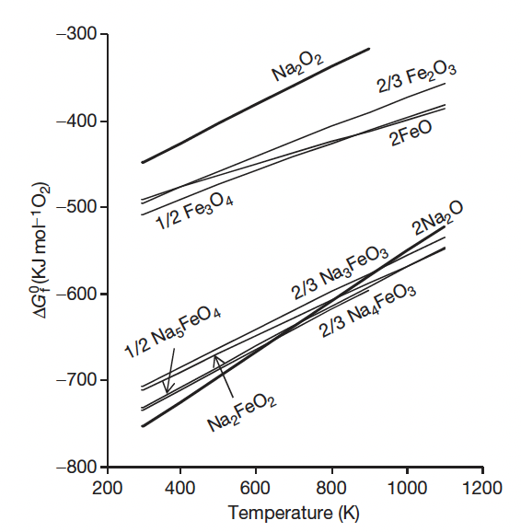
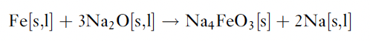
Sodium Corrosion
These are the paths for contamination through oxides adhering to the components and the impurities in the gas
The control of impurities in sodium can be achieved by using techniques to deposit the dissolved impurities in sodium
The thermodynamically stable oxide in sodium is sodium oxide, Na2O
Fe spontaneously reacts with Na2O above 380C, forming Na4FeO3

Slide 37
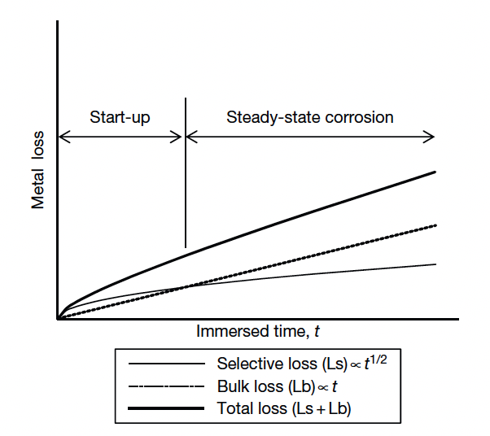
Na Corrosion of Steel
The important factors which influence the corrosion of the steels in sodium are: (1) immersion time, (2) temperature, (3) dissolved oxygen, (4) sodium velocity, (5) alloy elements, and (6) carburization and decarburization
Ni and Mn have high Na solubilities and dissolve first in selective (start-up) corrosion, whereas Fe corrodes in general (steady-state) corrosion

Slide 38
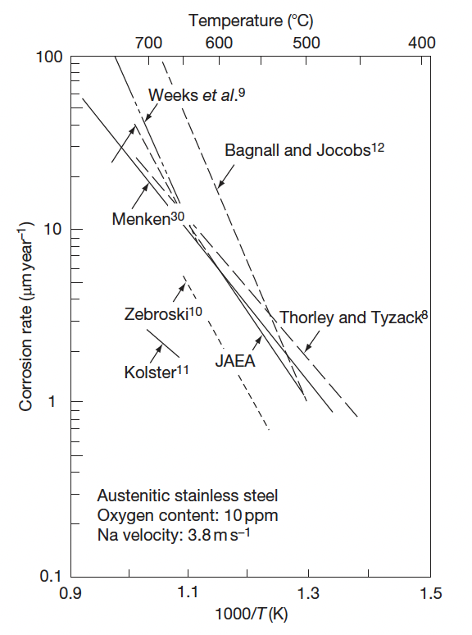
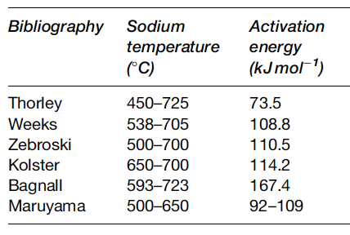
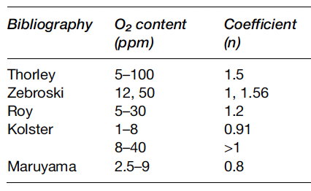
Na Corrosion of Steel
Corrosion rate follows an Arrhenius function
The activation energy is a function of temperature, and agrees with the activation energy of solubility in Na
This matches the understanding of corrosion through dissolution processes
The corrosion rate is proportional to the oxygen concentration to a power n
Thus, limiting O2 in the Na can limit corrosion

Slide 39
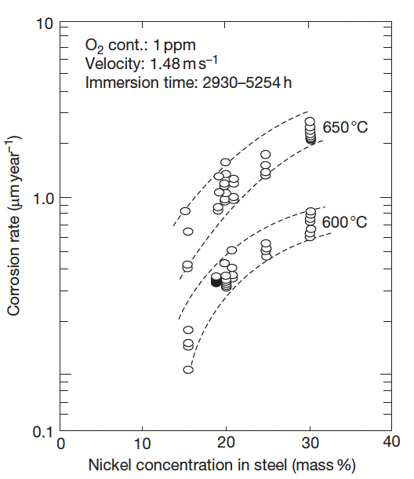
Na Corrosion in Steel
Because this is a dissolution driven process, the alloying elements are key to corrosion rates
Ni is especially soluble in Na, and as Ni content increases, corrosion rates increase
Cr has a much low solubility in Na and is thus preferred as an alloying element for Na-facing components
Decarburization or steels can also occur due to the temperature-dependent solubility of C in Na

Slide 40
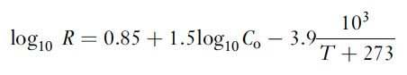
Na Corrosion in Monju
A corrosion formula was applied for the design and operation of the SFR Monju, where the rate R is in mm/yr
This equation is valid for structural materials types 304SS, 316SS, 321SS, and 2.25Cr–1Mo steel, and takes into account temperature and dissolved oxygen concentration
Slightly modified equations were developed for cladding materials

Slide 41
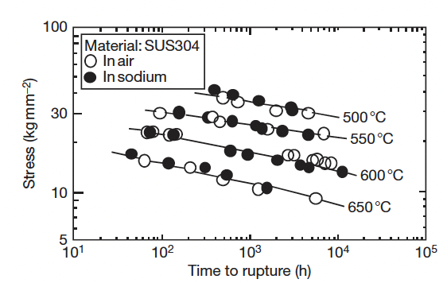
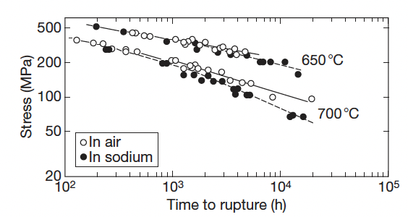
Sodium Effects on Mechanical Properties
The effect of sodium on the mechanical strength of steel is determined by three factors: (a) corrosion and mass transfer, (b) decarburization and carburization, and (c) reduction
Since the cladding tubes are thin components and are exposed to high temperatures, the sodium corrosion affecting the base metal is larger than that of the structural materials
Creep Strength

Slide 42
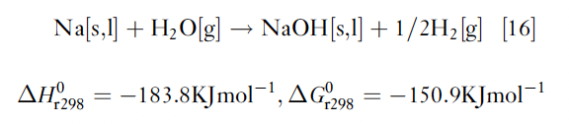
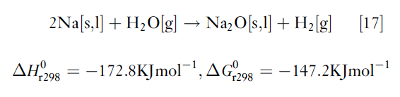
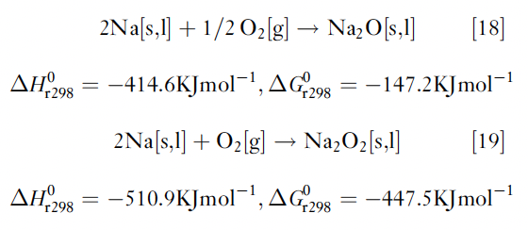
Na-Water/Air Reactions
One of the weak points of the present SFRs is the steam generator
If the steam generator tube is damaged, high-temperature pressurized steam is blown into the sodium
The environment around the failed tube is heated to high temperature (potentially up to 1200C) due to exothermic reactions
When high-temperature sodium is leaked into the atmosphere, it reacts with oxygen, and sodium oxides are formed

Slide 43
Questions?

